Slide 1
MOAT ACADEMY FOR DEVELOPERS
WEB APPLICATION DEVELOPMENT TRAINING
Designing Responsive websites with Bootstrap 4.5

Slide 2
Responsive websites are websites that can adapt to the screen of your device…

Slide 3

The site displays properly on various devices without the need to scroll sideways

Slide 4
Before We Start :
Declaring a DOCTYPE : Bootstrap makes use of global styles and settings to remove the effects of cross browser anomalies. Hence always include the HTML5 doctype at the beginning of the page
Include the lang attribute in the html tag
Modify your tags to look like the following:
  <!doctype html>
  <html lang="en">
  ...
  </html>

Slide 5
Parts of a Starter Bootstrap Template
Required meta tags : Include the following meta tags:
  <meta charset="utf-8">
  <meta name="viewport" content="width=device-width, initial-scale=1, shrink-to-fit=no">*
Bootstrap CSS
Javascript for the moving parts : jQuery first, then Popper.js, then Bootstrap JS
  JS at the bottom is a good practice as js loads slower than css
  Since JS is for interactivity, it is safe to allow our layout loads completely before the JS.
  Inclusion from the server or CDN
Notes:
* Its important when simulating the mobile view on web browser Chrome, Mozilla etc

Slide 6
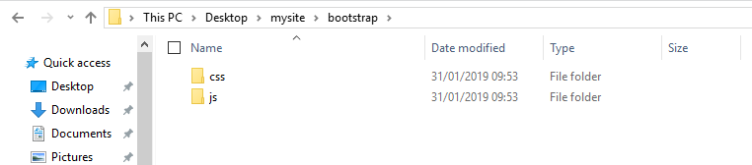
Downloaded Files

Slide 7
Bootstrap Layout
Bootstrap’s grid system uses DIVs to form a combination of containers, rows, and columns to layout and align content.
The containing div wraps around the elements, you can choose from the following container classes to choose from:
    The .container class provides a responsive fixed width container
    The .container-fluid class provides a full width container, spanning the entire width of the viewport.
Bootstrap makes use of a grid system that imaginarily divides the screen to 12 columns, the columns will re-arrange automatically depending on the screen size.
In bootstrap, the layout of your webpage is set with 3 very important classes. The container for wrapping the website, the row for the horizontal sections and the various variants of columns for creating the columns (grids).
.container and .container-fluid for a full width container, spanning the entire width of the viewport.
Notes:
The 3rd cate

Slide 8
Compare: The Bootstrap Grid System vs Table Layout
  Just as you have your web contents enclosed inside the table tag when using table layout, compare the below:
  <table>
    <tr><td> Contents </td></tr>
  </table>
  <div class=‘container’>
    <div class=‘row’><div class=‘col’> Contents </div></div>
  </div>
  Bootstrap makes use of a grid system that imaginarily divides the screen to 12 columns
  The column can further be specified with col-Number (eg col-6)

Slide 9
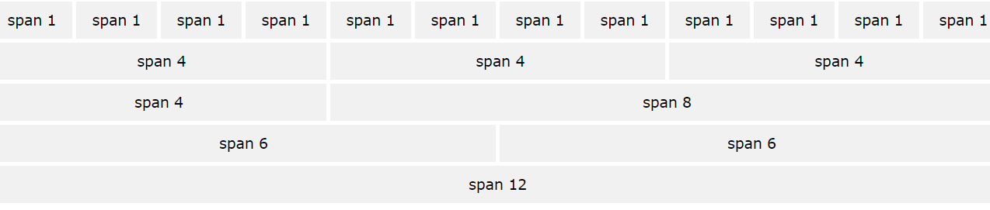
The number in col-Number determines the width of your div (everything is 12, remember?)

Slide 10
We can further specify breakpoints for our columns: the point (device) at which our divs stop standing side by side

Slide 11
Device Categories: Bootstrap Grid Classes
The Bootstrap 4 grid system has five classes:
    .col- (extra small devices - screen width less than 576px)
    .col-sm- (small devices - screen width equal to or greater than 576px)
    .col-md- (medium devices - screen width equal to or greater than 768px)
    .col-lg- (large devices - screen width equal to or greater than 992px)
    .col-xl- (xlarge devices - screen width equal to or greater than 1200px)
Classes can be combined, each class scales up, setting width for sm also means md has same definition. If the divs total more than 12, the excess will wrap over to the next line. *
Notes:
* This may be desirable in some situations like photo gallery, grid contents on blogs etc

Slide 12
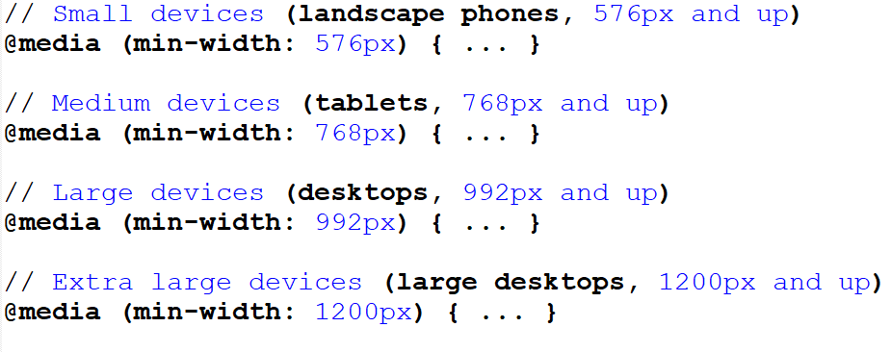
Under the hood, achieving breakpoints is powered by media query
Notes:
// Small devices (landscape phones, 576px and up)
@media (min-width: 576px) { ... }
// Medium devices (tablets, 768px and up)
@media (min-width: 768px) { ... }
// Large devices (desktops, 992px and up)
@media (min-width: 992px) { ... }
// Extra large devices (large desktops, 1200px and up)
@media (min-width: 1200px) { ... }

Slide 13
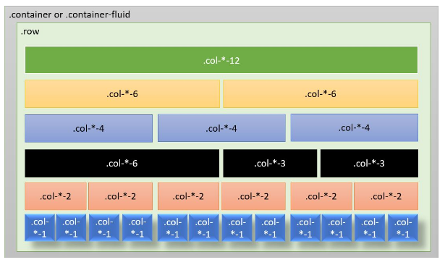
Bootstrap Grid Classes : The breaking point general formula

Slide 14
Bootstrap Grid Classes
The container div is followed by the <div class="row"> and then the column with the syntax : col-*-*
The first star (*) represents the responsiveness: sm, md, lg or xl, while the second star represents a number, which should add up to 12 for each row.
Using .col alone will handle the width automatically by creating equal width on all devices, col-responsiveness will create equal columns on the target specified. That is: .col-md will create equal columns (from the remaining space) on desktop devices while the columns will stack on smaller devices.

Slide 15
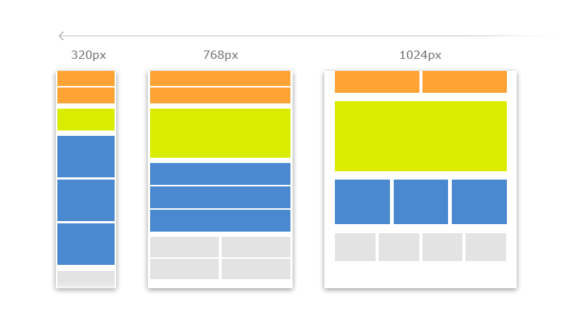
Responsive Website Layout – Target Devices
Notes:
The grids will stack when viewed from devices that are smaller than the target device.
You can specify more than one device class for a single div

Slide 16

Achieve the following by specifying the appropriate col class for the red divs
Note: edit the attached html file
Notes:
<!DOCTYPE html>
<html lang="en">
<head>
<title>Week 3 Responsive Website</title>
<link rel="stylesheet" type="text/css" href="css/bootstrap.css">
<meta charset="utf-8">
<meta name='viewport' content='width=device-width, initial-scale=1,shrink-to-fit=no'>
<style type="text/css">
.grey{ background-color: rgb(218, 219, 221); min-height:100px;margin:5px; }
.red{ background-color: rgb(145, 10, 7) ; min-height:100px;margin:5px; }
</style>
</head>
<body>
<div class="container">
<div class="row">
<div class="col grey"></div>
</div>
<div class="row">
<div class="col grey"></div>
</div>
<div class="row">
<div class="red"> a </div>
<div class="red"> b </div>
<div class="red"> c </div>
</div>
<div class="row">
<div class="col grey">content</div>
</div>
<div class="row">
<div class="col grey">footer</div>
</div>
</div>
</body>
</html>

